Slide 1
Officer Data Card (ODC)
Records Maintenance
Updated Jan 2022

Slide 2
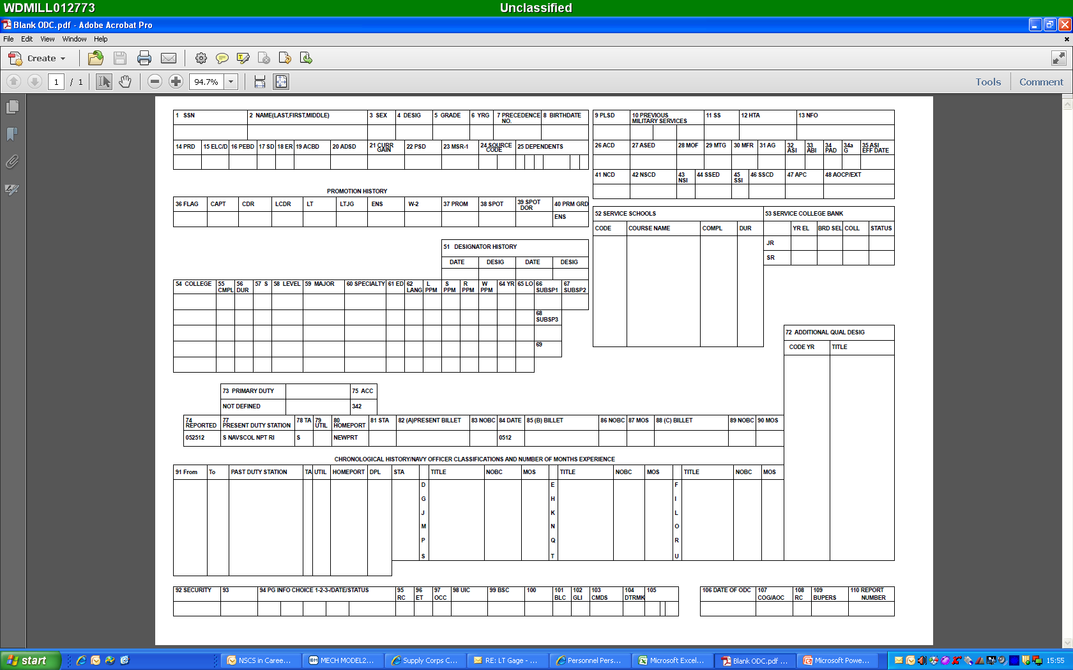
Year
Group
Social Security #
Full Name
Current
Rank
M/F
Auto-fill
Auto-fill
Auto-fill
Planned
Rotation Date
Pay Entry
Base Date
Active Duty Start Date
XXX
* To submit your transcripts and have the education blocks updated, see Note 5 on the following slides.
Some examples:
BQC
Basic Leadership
SODHC
ILC
JASMMM
SOBC
* To update, see Note 1 on the following slides.
* To calculate your APC, see Note 2 on the following slides.
XXXXXX
XX
XXXX
XXXXX
XXX
XXX
XXX
For a complete list of approved AQD’s, please visit the NOOCS Manual, Volume I, Part D.
Supply Corps AQD’s are 900-series.
* To update your subspecs or submit an experience subspec request, see Note 4 on the following slides.
* Where you are at now … Cannot adjust these blocks until AFTER you depart and this info falls into Block 91 below.
XXXX
XXXX
XXXX
* NOBCs track what job you ACTUALLY filled at your command (1918, 1990, 1991, etc.). For a
full list of approved NOBCs and the process for adding them to Block 91, see Note 6 on the following slides.
* PG School preferences (see Note 3 on the following slides).
XXX
XXX
XXX

Slide 3
“How To” Guide
Notes
Service Schools: At a minimum, every Supply Corps officer (310X) should have at least BQC and Basic Leadership in this block! For a complete listing of approved Service Schools that can be annotated in Block 52, please reference the NOOCS Manual, Volume II, Appendix C. Once you have identified the Service Schools you want added (room for six total), email My Navy Career Center (MNCC) (askmncc@navy.mil) the following blurb. You must include a copy of your Joint Service Transcript or the Certificate of Completion confirming your attendance at the respective school. If the school in question is not listed in the NOOCS Manual, it cannot go on your ODC. Block 52 of your ODC feeds the Service School Block of your Officer Summary Record (OSR). By updating your ODC, you automatically update your OSR.
“Dear MNCC,
Please update Block 52 of my ODC with the following Service School(s). My Joint Service Transcript / Certificate of Completion is attached for your reference.
Course Title: ________ (per NOOCS Manual)
School Location: ________
Completion Date: ________
Course Duration: ________ (weeks)
3-Digit School Code: ________ (per NOOCS Manual)
I can be reached at ________@navy.mil if you have any questions. Thank you for your assistance.”
APC Code: To have your APC calculated, login into the NPS website and begin the application process. You are not actually applying for NPS, it’s just how the process is set-up to work. The application will instruct you to submit official transcripts to NPS, upon receipt your APC will be calculated. You APC should post to your ODC within three weeks of calculation. APC’s are not set in stone … they can be improved! Identify the required APC score for the PG School curriculum you are most interested in (It’s Your Education) and then work with the NPS Admissions Team (admissions@nps.edu) to identify the school and classes you need to take.
PG School Preferences: These three blocks capture all the curriculum codes listed in the It’s Your Education playbook, with the exception of 810 and 811 (which are applied for through submitting a package). Once you identify your three curriculum code preferences, send an email to the Career Counselor to have your record updated.
Important: After sending your email, you will receive a response with a ticket number. If you do not receive a response, you should contact MNCC to get your ticket number, which is needed for tracking purposes.

Slide 4
“How To” Guide (continued)
Subspecialty Codes (SSP): Earned through education and/or experience. The most common SSPs for SC officers are 1301, 1302, 1306, 1307, 1309, 3111, and 3212. For a complete list of Navy SSP codes, refer to the NOOCS Manual at https://www.mynavyhr.navy.mil/References/NOOCS-Manual/.
The breakdown of suffix codes is as follows:
  G – Master’s degree (non-Navy funded)
  P – Master’s degree (i.e. - 815 graduates earn a 1306P out of NPS)
  F – Master’s degree (non-Navy funded) + 18 months of experience in a “coded” billet (i.e. – 1301G + 18 mos. in a “1306S-coded” billet = 1301F)
  Q – Master’s degree + 18 months of experience in a “coded” billet (i.e. – 1306P + 18 mos. in a “1306S-coded” billet = 1306Q)
  S – 18 mos. of experience in a “coded” billet (i.e. – 18 months in a 1306S-coded billet = 1306S)
  R – Two (2x) separate experience tours, each greater than 18 months in length, in a coded billet (i.e. – 1306S + 1306S = 1306R)
  IMPORTANT: If you earn an MBA on your own, you may qualify for the 1301G SSP!
  SSP experience requests can be submitted per the directions below (only one per tour). The duties of the billet must be closely related to the core skill requirements for the requested subspecialty. The duties must be documented in the Officer's Fitness Reports.
You can request an experience subspecialty through self-nomination submission to supply_corps_cc@navy.mil. Experience requests must:
    Include Fitness Reports for experience periods (18 month minimum)
    Include command endorsement letter
    Include a return e-mail address or phone number
    Education requests must:
    Include Transcripts (official or unofficial)
    Include Catalog Course Descriptions for courses that appear on Transcript
    Directions for preparing and submitting subspecialty requests can be found on NPC’s education webpage at:
    https://www.mynavyhr.navy.mil/Career-Management/Education/Subspecialty/
    Directions and sample self-nomination requests can be found on the Supply Corps Career Counselor webpage at:
    https://www.mynavyhr.navy.mil/Career-Management/Detailing/Officer/Pers-44-Staff-RL/Supply-Corps-Officer/Sample-Letters/
References: MILPERSMAN 1214-010 and NAVPERS 15839I.

Slide 5
“How To” Guide (continued)
Education: To update the education blocks, contact your university registrar’s office and have them send official, sealed copies of your transcripts to the address below:
Navy Personnel Command
MNCC
BUILDING 768 RM E302
5720 INTEGRITY DRIVE
MILLINGTON, TN 38055
The team at MNCC filters out anything that may be Navy-Sponsored and PERS-451 reviews it. PERS-451 receives reports for NPC, NWC and other sponsored programs where the member incurs an obligation. If your ODC/OSR Education block is blank, your transcripts are not on file. Transcripts submitted as part of commissioning packages, intern packages, etc., are destroyed after the board, and do not feed into NPC’s system.
NOBCs: NOBCs are used to identify the job(s) you filled throughout your tour. Often, the job an officer actually ends up filling is different than the one detailed to. For a complete list of NOBCs, refer to NOOCS Manual, Volume I, Part C. Once the tour is listed in Block 91 of your ODC, you can request a total of three per tour. SC-centric NOBCs are found between in series 1000-1999 and your FITREPs must explicitly speak to the experience. To request a NOBC update to ODC Block 91 send an email to My Navy Career Center (MNCC) (askmncc@navy.mil) with the following:
Dear MNCC,
Please update Block 91 of my ODC to read:
From: XXXX-XXXX (enter dates per your ODC)
Title: (per the NOOCS Manual)
NOBC: XXXX (four-digit number per NOOCS Manual)
MOS: XX (per FITREPs)
FITREPs supporting this request are attached as well.
I can be reached at ________@navy.mil if you have any questions. Thank you.“
Important: After sending your email, you will receive a response with a ticket number. If you do not receive a response, you should contact MNCC to get your ticket number, which is needed for tracking purposes.

